Slide 1
Unit 5.1 System Implementation
Introduction, System Implementation (Coding, Testing and Installation Process, Deliverables and Outcomes from Coding, Testing, Installation, Documenting, and Training and Supporting Users), Software Application Testing (Different Types of Testing, the Testing Process), Installation (Installation and its Types), Documenting the System, Training and Supporting Users, Organizational Issues in Systems Implementation

Slide 2
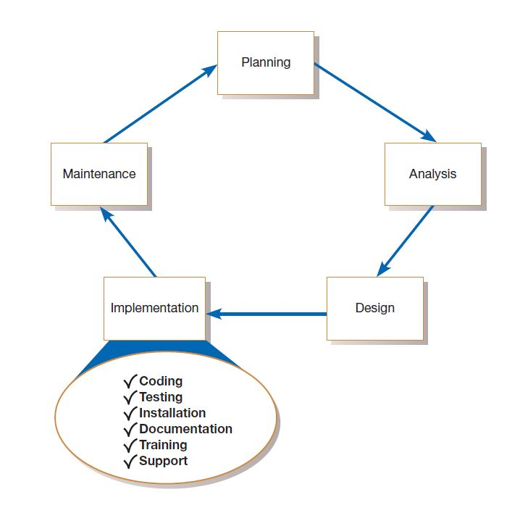

Slide 3
The purpose of implementation is to build a properly working system, install it in the organization, replace old systems and work methods, finalize system and user documentation, train users, and prepare support systems to assist users. Implementation also involves closedown of the project, including evaluating personnel, reassigning staff, assessing the success of the project, and turning all resources over to those who will support and maintain the system.
The purpose of maintenance is to fix and enhance the system to respond to problems and changing business conditions. Maintenance includes activities from all systems development phases. Maintenance also involves responding to requests to change the system, transforming requests into changes, designing the changes, and implementing them.

Slide 4
System implementation is made up of many activities. The six major activities we are concerned with this are coding, testing, installation, documentation, training, and support. The purpose of these steps is to convert the physical system specifications into working and reliable software and hardware, document the work that has been done, and provide help for current and future users and caretakers of the system. Coding and testing may have already been completed by this point if Agile Methodologies have been followed. Using a plan-driven methodology, coding and testing are often done by other project team members besides analysts, although analysts may do some programming. In any case, analysts are responsible for ensuring that all of these various activities are properly planned and executed. Next, we will briefly discuss these activities in two groups:
coding, testing, and installation
documenting the system and training and supporting users

Slide 5
Coding is the process whereby the physical design specifications created by the analysis team are turned into working computer code by the programming team. Depending on the size and complexity of the system, coding can be an involved, intensive activity. once coding has begun, the testing process can begin and proceed in parallel. As each program module is produced, it can be tested individually, then as part of a larger program, and then as part of a larger system.
Installation is the process during which the current system is replaced by the new system. This includes conversion of existing data, software, documentation, and work procedures to those consistent with the new system. Users will sometimes resist these changes, and you must help them adjust. However, you cannot control all the dynamics of user–system interaction involved in the installation process.

Slide 6
Users: Although the process of documentation proceeds throughout the life cycle, it receives formal attention during the implementation phase because the end of implementation largely marks the end of the analysis team’s involvement in systems development. As the team is getting ready to move on to new projects, you and the other analysts need to prepare documents that reveal (give information) all of the important information you have accumulated about this system during its development and implementation. There are two audiences for this final documentation:
the information systems personnel who will maintain the system throughout its productive life, and
the people who will use the system as part of their daily lives. The analysis team in a large organization can get help in preparing documentation from specialized staff in the information systems department.
Larger organizations also tend to provide training and support to computer users throughout the organization. Some of the training and support is very specific to particular application systems, whereas the rest is general to particular operating systems or off-the-shelf software packages.

Slide 7
Program testing
Testing is intended to show that a program does what it is intended to do and to discover program defects before it is put into use.
When you test software, you execute a program using artificial data.
You check the results of the test run for errors, anomalies or information about the program’s non-functional attributes.
Can reveal the presence of errors NOT their absence.
Testing is part of a more general verification and validation process, which also includes static validation techniques.

Slide 8
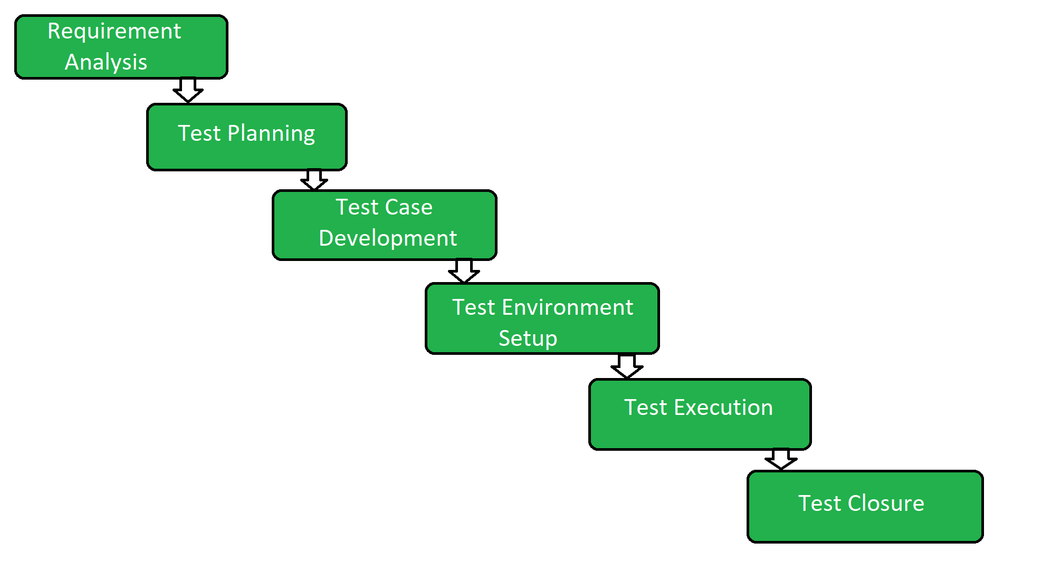

Slide 9
Program testing goals
To demonstrate to the developer and the customer that the software meets its requirements.
For custom software, this means that there should be at least one test for every requirement in the requirements document. For generic software products, it means that there should be tests for all of the system features, plus combinations of these features, that will be incorporated in the product release.
To discover situations in which the behavior of the software is incorrect, undesirable or does not conform to its specification.
Defect testing is concerned with rooting out undesirable system behavior such as system crashes, unwanted interactions with other systems, incorrect computations and data corruption.

Slide 10
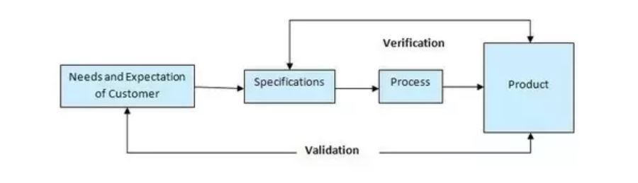
Verification vs validation

Slide 11
Inspections and testing
Software inspections Concerned with analysis of the static system representation to discover problems (static verification)
May be supplement by tool-based document and code analysis.
Software testing Concerned with exercising and observing product behaviour (dynamic verification)
The system is executed with test data and its operational behaviour is observed.

Slide 12
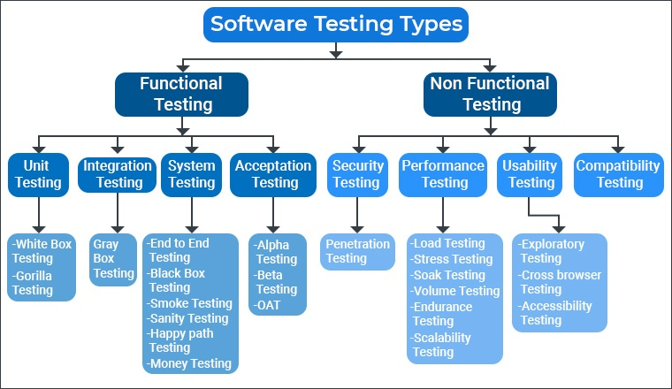

Slide 13
Static testing means that the code being tested is not executed. The results of running the code are not an issue for that particular test.
Dynamic testing, on the other hand, involves execution of the code.
Automated testing means the computer conducts the test, whereas manual testing means that people complete the test .

Slide 14
Inspections: A testing technique in which participants examine program code for predictable language-specific errors that is participants manually examine code for occurrences of well-known errors. Syntax, grammar, and some other routine errors can be checked by automated inspection software, so manual inspection checks are used for more subtle ( small ) errors. Each programming language lends itself to certain types of errors that programmers make when coding, and these common errors are well-known and documented. Exactly what the code does is not investigated in an inspection. It has been estimated that code inspections detect from 60 to 90 percent of all software defects as well as provide programmers with feedback that enables them to avoid making the same types of errors in future work (Fagan, 1986).
Desk checking : A testing technique in which the program code is sequentially executed manually by the reviewer. It is informal process in which the programmer or someone else who understands the logic of the program works through the code with a paper and pencil. The programmer executes each instruction, using test cases that may or may not be written down. In one sense, the reviewer acts as the computer, mentally checking each step and its results for the entire set of computer instructions.

Slide 15
Unit testing: sometimes called module testing, is an automated technique whereby each module is tested alone in an attempt to discover any errors that may exist in the module’s code. But because modules coexist and work with other modules in programs and the system, they must also be tested together in larger groups.
Integration testing: Combining modules and testing them is called integration testing. Integration testing is gradual. First you test the coordinating module and only one of its subordinate modules. After the first test, you add one or two other subordinate modules from the same level. Once the program has been tested with the coordinating module and all of its immediately subordinate modules, you add modules from the next level and then test the program. You continue this procedure until the entire program has been tested as a unit.
System testing: System testing is a similar process, but instead of integrating modules into programs for testing, you integrate programs into systems. System testing follows the same incremental logic that integration testing does. Under both integration and system testing, not only do individual modules and programs get tested many times, so do the interfaces between modules and programs.

Slide 16
Black box testing: It is defined as a testing technique in which functionality of the application under test is tested without looking at the internal code structure, implementation details and knowledge of internal paths of the software. This type of testing is based entirely on software requirements and specifications. In this testing, we just focus on inputs and output of the software system without bothering about internal knowledge of the software program. In black box test ( also called functional test ) internal code of the program are tested. It is called black box testing because the test cases are totally hidden for the general users.
White box testing: White box testing is a testing technique that examines the program structure and derives test data from the program logic/code. It is a software testing methodology that uses a program’s source code to design tests and test cases for quality assurance ( QA). The code structure is known and understood by the tester in white box testing. In white box test ( also called glass box test) structure of the program is tested. It is called white box testing because the test cases are totally visible to the general users and they can also make test cases.

Slide 17
Stub testing: Stubs are two or three lines of code written by a programmer to stand in for the missing modules. During testing, the coordinating module calls the stub instead of the subordinate module. The stub accepts control and then returns it to the coordinating module.
User acceptance testing: Once the system tests have been satisfactorily completed, the system is ready for acceptance testing, which is testing the system in the environment where it will eventually be used.

Slide 18
Installation
The process of moving from the current information system to the new one is called installation. All employees who use a system, whether they were consulted during the development process or not, must give up their reliance on the current system and begin to rely on the new system. Four different approaches to installation have emerged over the years: direct, parallel, single-location, and phased. The approach an organization decides to use will depend on the scope and complexity of the change associated with the new system and the organization’s risk aversion.

Slide 19
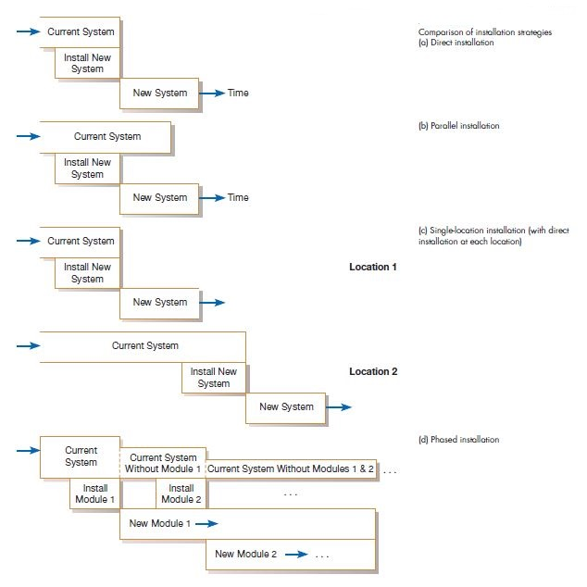

Slide 20
The Direct Installation t, or abrupt, approach to installation (also called “cold turkey”) is as sudden as the name indicates: The old system is turned off and the new system is turned on. Under direct installation, users are at the mercy of the new system. Any errors resulting from the new system will have a direct impact on the users and how they do their jobs and, in some cases—depending on the centrality of the system to the organization—on how the organization performs its business. If the new system fails, considerable delay may occur until the old system can again be made operational and business transactions are reentered to make the database up to date. For these reasons, direct installation can be very risky. Further, direct installation requires a complete installation of the whole system. For a large system, this may mean a long time until the new system can be installed, thus delaying system benefits or even missing the opportunities that motivated the system request. On the other hand, it is the least expensive installation method, and it creates considerable interest in making the installation a success. Sometimes, a direct installation is the only possible strategy if there is no way for the current and new systems to coexist, which they must do in some way in each of the other installation approaches.

Slide 21
Parallel installation is as riskless as direct installation is risky. Under parallel installation, the old system continues to run alongside the new system until users and management are satisfied that the new system is effectively performing its duties and the old system can be turned off. All of the work done by the old system is concurrently performed by the new system. Outputs are compared (to the greatest extent possible) to help determine whether the new system is performing as well as the old. Errors discovered in the new system do not cost the organization much, if anything, because errors can be isolated and the business can be supported with the old system. Because all work is essentially done twice, a parallel installation can be very expensive; running two systems implies employing (and paying) two staffs to not only operate both systems, but also to maintain them. A parallel approach can also be confusing to users because they must deal with both systems. As with direct installation, there can be a considerable delay until the new system is completely ready for installation. A parallel approach may not be feasible, especially if the users of the system (such as customers) cannot tolerate redundant effort or if the size of the system (number of users or extent of features) is large.

Slide 22
Single-location installation, also known as location or pilot installation, is a middleof- the-road approach compared with direct and parallel installation. Rather than convert all of the organization at once, single-location installation involves changing from the current to the new system in only one place or in a series of separate sites over time. The single location may be a branch office, a single factory, or one department, and the actual approach used for installation in that location may be any of the other approaches. The key advantage to single-location installation is that it limits potential damage and potential cost by limiting the effects to a single site. Once management has determined that installation has been successful at one location, the new system may be deployed in the rest of the organization, possibly continuing with installation at one location at a time. Success at the pilot site can be used to convince reluctant personnel at other sites that the system can be worthwhile for them as well. Problems with the system (the actual software as well as documentation, training, and support) can be resolved before deployment to other sites.

Slide 23
Phased installation, also called staged installation, is an incremental approach. With phased installation, the new system is brought online in functional components; different parts of the old and new systems are used in cooperation until the whole new system is installed. Phased installation, like single-location installation, is an attempt to limit the organization’s exposure to risk, whether in terms of cost or disruption of the business. By converting gradually, the organization’s risk is spread out over time and place. Also, a phased installation allows for some benefits from the new system before the whole system is ready. For example, new data-capture methods can be used before all reporting modules are ready. For a phased installation, the new and replaced systems must be able to coexist and probably share data. Thus, bridge programs connecting old and new databases and programs often must be built. Sometimes, the new and old systems are so incompatible (built using totally different structures) that pieces of the old system cannot be incrementally replaced, so this strategy is not feasible. A phased installation is akin to bringing out a sequence of releases of the system. Thus, a phased approach requires careful version control, repeated conversions at each phase, and a long period of change, which may be frustrating and confusing to users. On the other hand, each phase of change is smaller and more manageable for all involved.

Slide 24
Documenting the System
Documentation is the process of collecting, organizing, storing and maintaining a complete record of system and other documents used or prepared during the different phases of the life cycle of system. System cannot be considered to be complete, until it is properly documented. Proper documentation of system is necessary due to the following reasons:
It solves the problem of indispensability (not willing ) of an individual for an organization. Even if the person, who has designed or developed the system, leaves the organization, the documented knowledge remains with the organization, which can be used for the continuity of that software.
It makes system easier to modify and maintain in the future. The key to maintenance is proper and dynamic documentation. It is easier to understand the concept of a system from the documented records.
It helps in restarting a system development, which was postponed due to some reason. The job need not be started from scratch, and old ideas may still be easily recapitulated from the available documents, which avoids duplication of work, and saves lot of times and effort.

Slide 25
System Documentation: System documentation records detailed information about a system’s design specification, its internal workings and its functionality. System documentation is intended primarily for maintenance programmers. It contains the following information:
A description of the system specifying the scope of the problem, the environment in which it functions, its limitation, its input requirements, and form and types of output required.
Detailed diagram of system flowchart and program flowchart.
A source listing of all the full details of any modifications made since its development.
Specification of all input and output media required for the operation of the system.
Problem definition and the objective of developing the programs.
Output and test report of the program.
Upgrade or maintenance history, if modification of the program is made.

Slide 26
There are two types of system documentation. They are:
Internal documentation: Internal documentation is part of the program source code or is generated at compile time.
External documentation: External documentation includes the outcome of structured diagramming technique such as dataflow an entity-relationship diagrams.

Slide 27
User documentation: User documentation consists of written or other visual information about an application system, how it works and how to use it. User documentation is intended primarily for users. It contains the following information:
Set up and operational details of each system.
Loading and unloading procedures.
Problems which could arise, their meaning reply and operation action.
Special checks and security measures.
Quick reference guides about operating a system in a short, concise format.

Slide 28
Training And Supporting Users
The type of training needed will vary by system type and user expertise. Types of training methods are:
Resident expert (to fellow users for training).
Traditional instructor-led classroom training.
E-learning/ distance learning.
Blended learning (combination of instructor-led and e-learning).
Software help components.
Electronic performance support system: component of a software package or an application in which training and educational information is embedded.
External sources, such as vendors.

Slide 29
Computing supports for users has been provided in one of a few forums:
Automating support: Online support forums provides users access to information on new releases, bugs and tips form more effective usage. Forums are offered over the internet or over company intranets.
Providing support through a help desk: A help desk is an information systems department function and is staffed by IS personnel. The help desk is the first place users should call when they need assistance with an information system. The help desk staff members either deal with the users questions or refer the users to the most appropriate person.

Slide 30
Organizational Issues In Systems Implementation
The best efforts of the systems development team is to design and build a quality system and to manage the change process in the organization, the implementation effort sometimes fails. Sometimes employees will not use the new system that has been developed for them or, if they do use it, their level of satisfaction with it is very low. Why do systems implementation efforts fail? This question has been the subject of information systems research for over 60 years.
Why Implementation Sometimes fails?
The conventional wisdom that has emerged over the years is that there are at least two conditions necessary for a successful implementation effort: management support of the system under development and the involvement of users in the development process (Ginzberg, 1981b). Conventional wisdom holds that if both of these conditions are met, you should have a successful implementation.

Slide 31
Management support and user involvement are important to implementation success, but they may be overrated compared to other factors that are also important. Research has shown that the link between user involvement and implementation success is sometimes weak (Ives and Olson, 1984). User involvement can help reduce the risk of failure when the system is complex, but user participation in the development process only makes failure more likely when there are financial and time constraints in the development process (Tait and Vessey, 1988). Information systems implementation failures are too common, and the implementation process is too complicated, for the conventional wisdom to be completely correct.
Over the years, other studies have found evidence of additional factors that are important to a successful implementation process. Three such factors are: commitment to the project, commitment to change, and the extent of project definition and planning (Ginzberg, 1981b).

Slide 32
Commitment to the project involves managing the systems development project so that the problem being solved is well understood and the system being developed to deal with the problem actually solves it.
Commitment to change involves being willing to change behaviors, procedures, and other aspects of the organization.
The extent of project definition and planning is a measure of how well the project was planned. The more extensive the planning effort is, the less likely implementation failure is. Still another important factor related to implementation success is user expectations (Ginzberg, 1981a). The more realistic a user’s early expectations about a new system and its capabilities are, the more likely it is that the user will be satisfied with the new system and actually use it.

